Slide 1
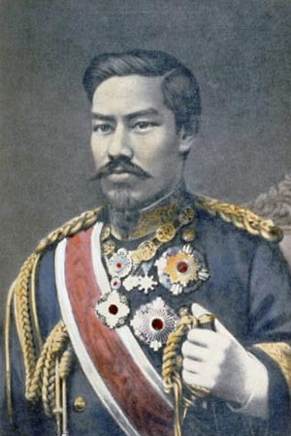
Chapter 13: New Global Patterns (1800-1914) Japan Modernizes
Focus Question: How did Japan become a modern industrial power, and what did it do with its new strength?
Emperor Meiji
https://youtu.be/nPhi7mZmsSY
10 minutes

Slide 2
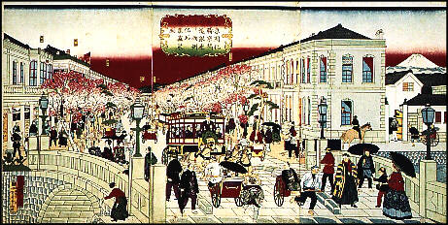
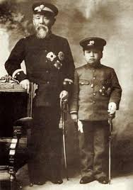
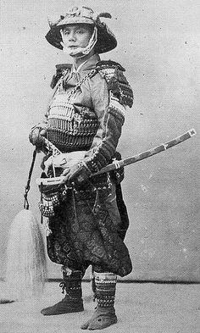
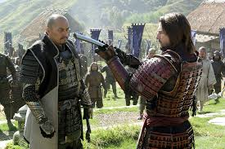

Slide 8
Answer: The graph shows an increase in the amount of yen invested in various economic activities, showing that the Meiji reforms brought a strong increase in Japan’s economic strength, particularly in industry.
Question: How does the graph reflect the Meiji reformers’ drive to industrialize Japan?

Slide 9
